Slide 1
Brain Tumor Segmentation
Fall25 Deep Learning Systems
Tri Nguyen
Priyanka Prem Kumar
Varalakshmi Perumal

Slide 2
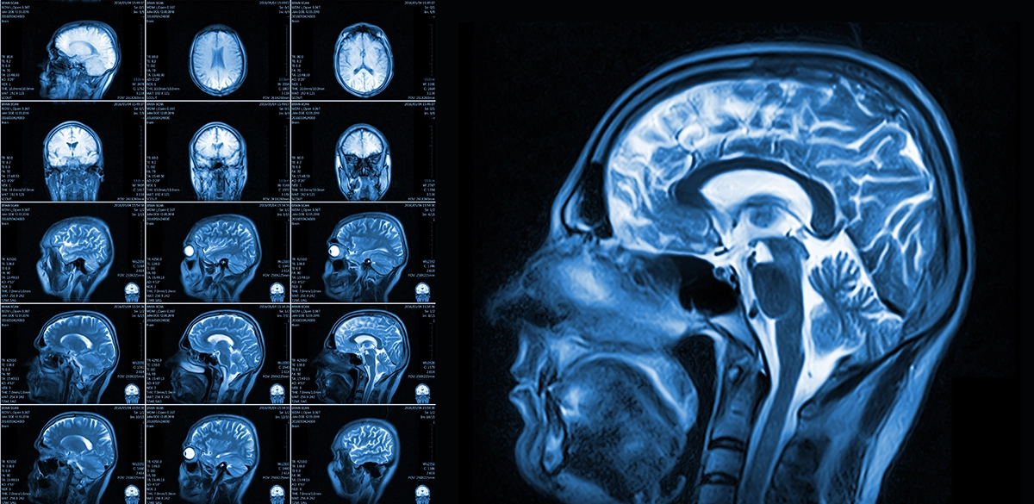
Project Description
Brain tumors require highly accurate detection and monitoring while MRI is a standard tool to detect and assessing brain tumors
MRI provides detailed anatomical information however it is complex and time intensive
Automated deep-learning segmentation is idea solution to support the clinicians by improving consistency, reducing workload

Slide 3
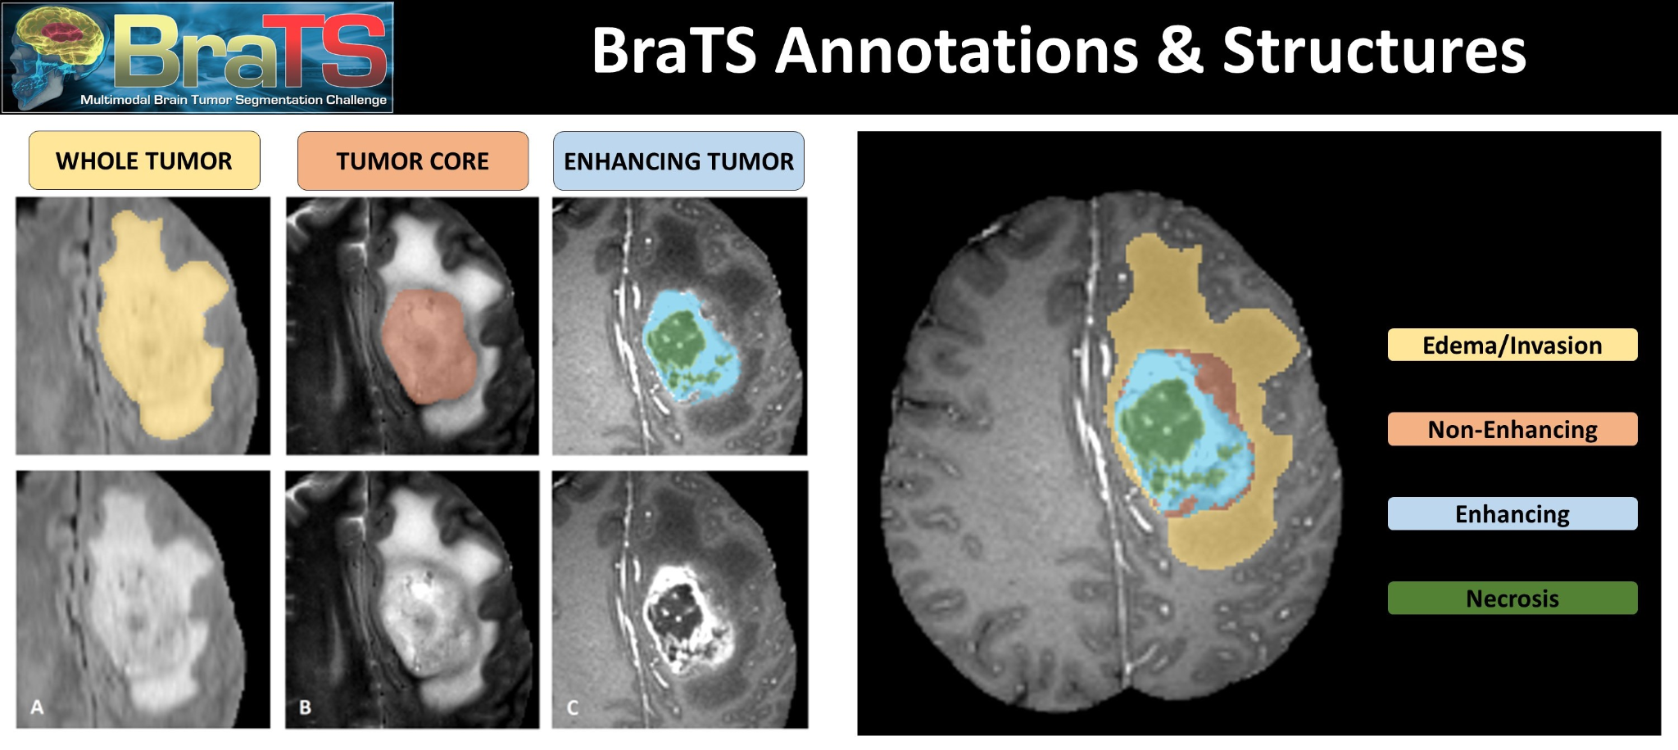
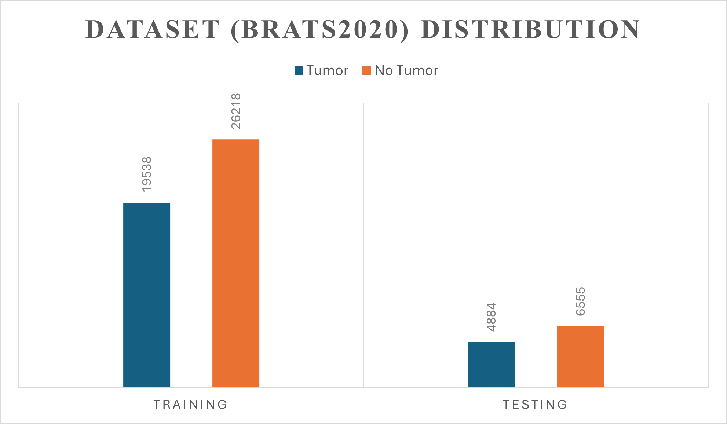
Datasets
The BraTS (Brain Tumor Segmentation) dataset is an annual MICCAI challenge focused on benchmarking automated brain tumor segmentation methods.
Each patient includes four MRI modalities—T1, post-contrast T1 (T1ce), T2, and FLAIR—capturing complementary structural and pathological information.
Expert-annotated segmentation masks label three key tumor subregions: Enhancing Tumor (ET), Tumor Core (TC), and Whole Tumor (WT), enabling supervised deep learning training and evaluation.

Slide 4
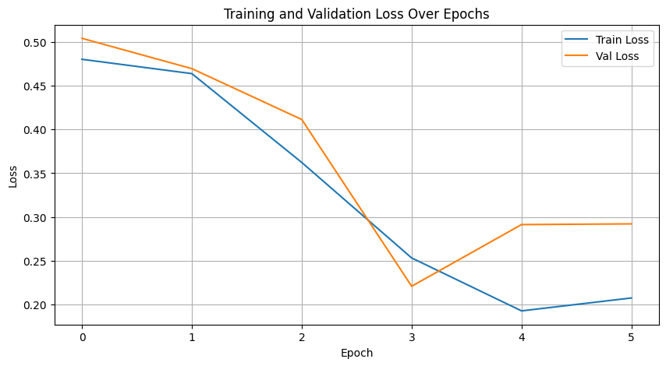
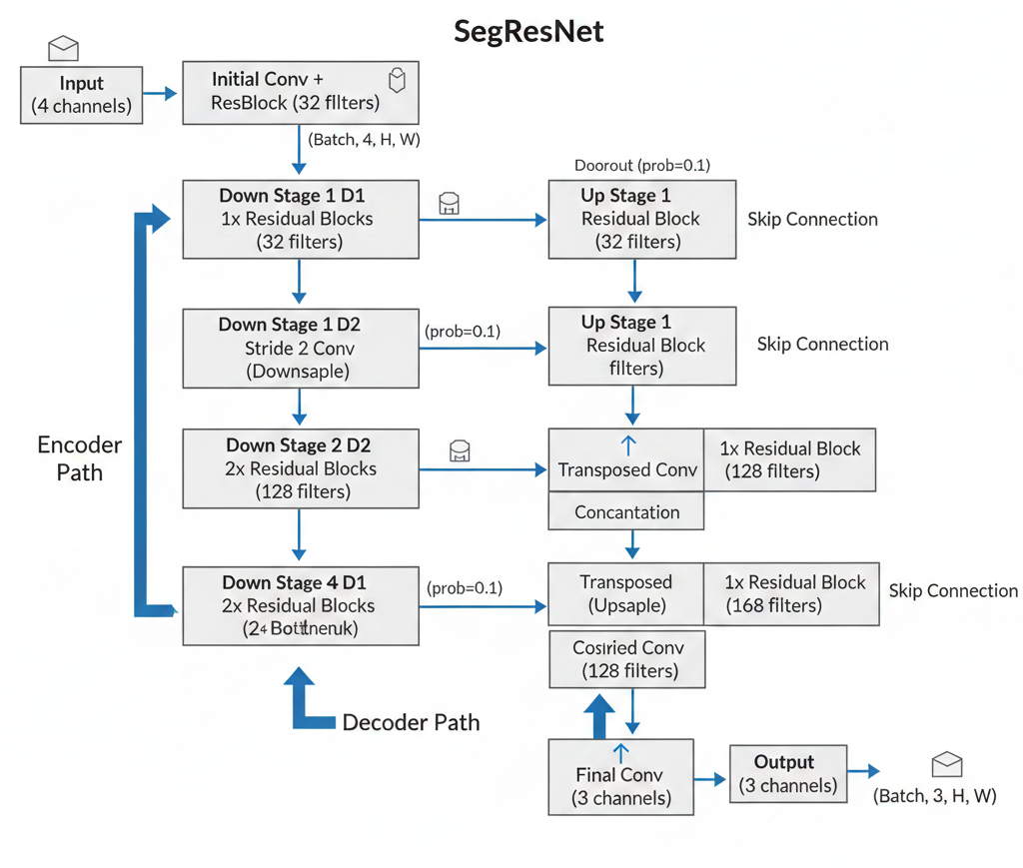
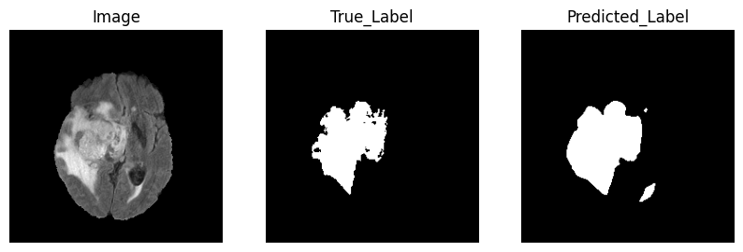
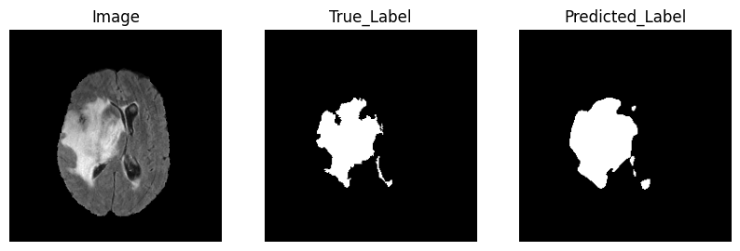
SegResNet

Slide 5
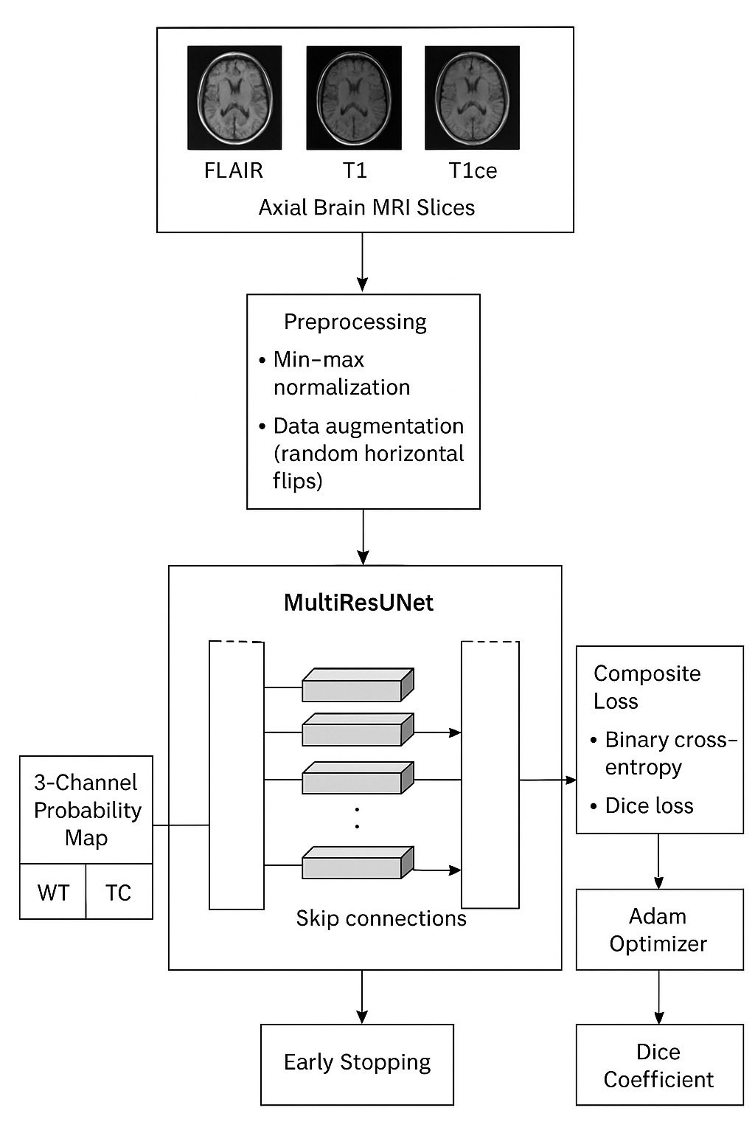
MultiResUNet Model Architecture
Built on U-Net with MultiRes blocks for richer multi-scale feature learning
Residual connections help align encoder and decoder representations
Encoder uses stacked MultiRes blocks with max pooling for downsampling
Decoder uses transposed convolutions and skip connections to restore spatial detail
Final 1×1 convolution outputs three tumor region probability maps (WT, TC, ET)

Slide 6
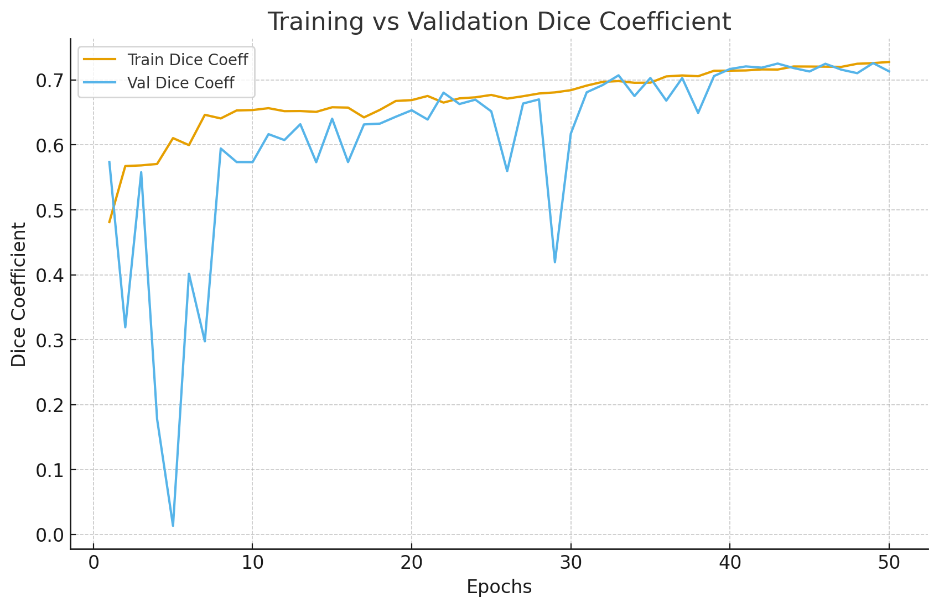
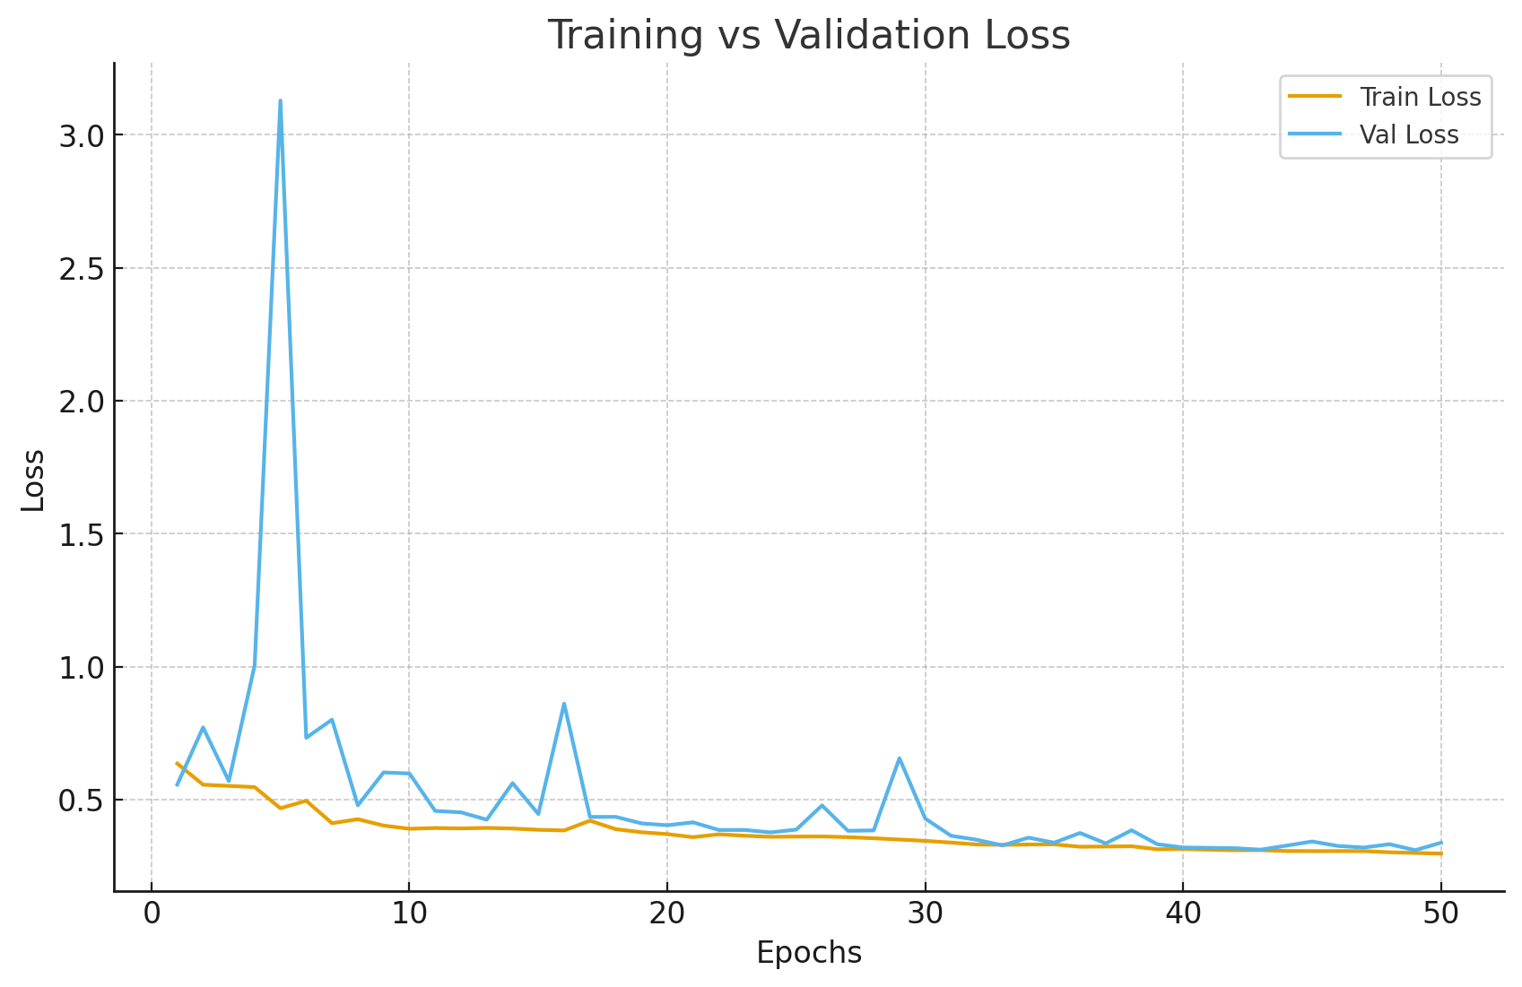
Experimental Results: Training Performance and Observations
Training and validation loss steadily decrease over 50 epochs.
Sharp drop in first 10–15 epochs → rapid learning of basic tumor vs. background features.
Curves plateau around 30 epochs → model reaches stable minimum. Close alignment between training and validation → good generalization.
Dice coefficient steadily increases, small training-validation gap → reliable performance on unseen data.

Slide 7
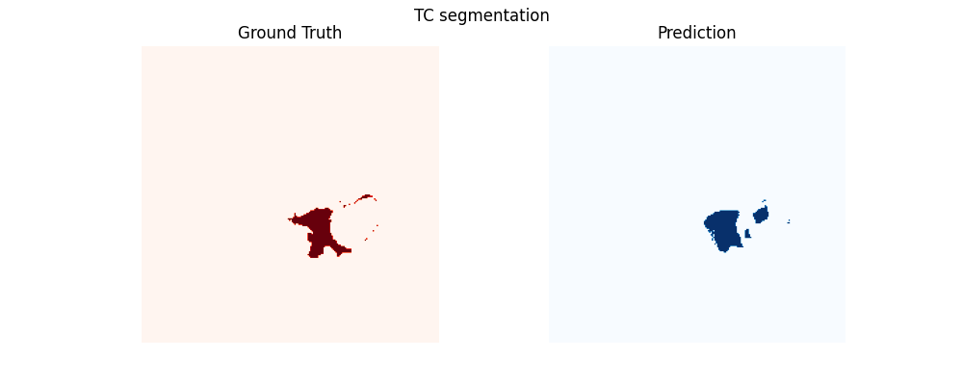

Experimental Results - Qualitative Evaluation
Predicted masks accurately capture tumor boundaries, including irregular shapes.
Whole Tumor (WT) predictions show consistent coverage across slices.
Tumor Core (TC) nested correctly within WT → anatomically consistent.
Enhancing Tumor (ET) regions identified → sensitive to fine-scale features.
Predictions align with ground truth, avoid false positives, maintain slice-to-slice consistency.

Slide 8
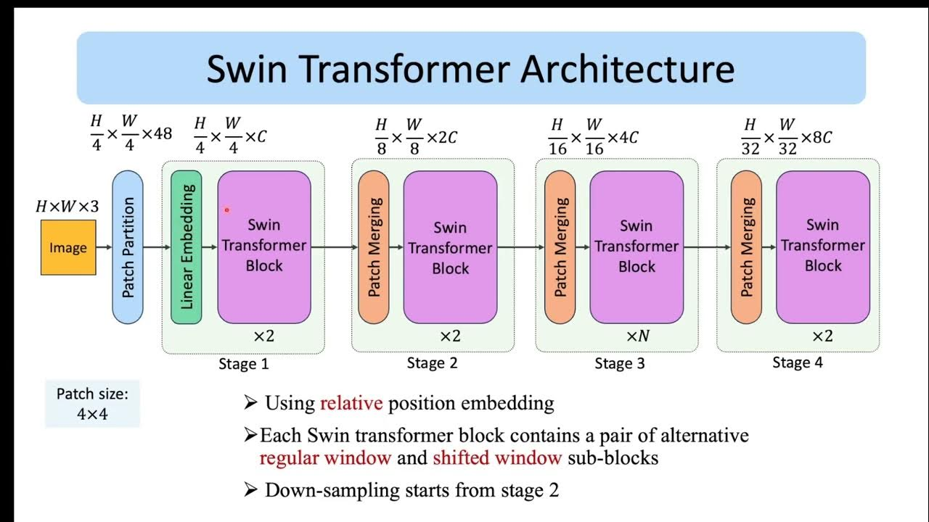
Swin Transformer
Hybrid swin-transformer encoder with depths (2,2,6,2) and heads (3,6,12,24)
Decoder: follows Unet Architecture to upsampling channels from 768 to 96 to reproduce 224x224
Training with AdamW and with 30 epochs with Dice Loss
However, it converges after 3 epochs and show no learning

Slide 9
Conclusion
Training Stability:
Smooth decrease in loss and steady increase in Dice scores.
Closely aligned training and validation trends indicate stable convergence and good generalization.
Accurate Segmentation:
Predicted masks closely match tumor boundaries and avoid false positives.
Whole Tumor (WT), Tumor Core (TC), and Enhancing Tumor (ET) regions are accurately delineated.
Sub-region Detection:
Smaller regions like ET are successfully captured and properly nested within larger regions.
Robust Generalization:
High-quality predictions maintained across diverse tumor shapes, sizes, and slices.
Model effectively learns features applicable to unseen data.

Slide 10
Member Contribution
Tri Nguyen
Developed model for Swin-Unet Transformer
Filtering and cleaning the dataset
Contributing to the report
Drafting the presentation
Varalakshmi Perumal
Identifying the Project topic and find Dataset to work with.
Developed Model Training for SegResNet
Contribution to Report - Structured Abstract, Dataset and SegResNet
Presentation Drafted - SegResNet
Priyanka Prem Kumar
Developed Model Architecture and training for MultiResUNet
Evaluation and Developing the Loss function
Report contribution - Introduction, MultiResUNet methodology and results, Conclusion
Presentation Drafting - MultiResUNet

Slide 11
Related work
Using U-Net network for efficient brain tumor segmentation in MRI images
Introduces an encoder–decoder with skip connections that enables precise localization and efficient segmentation of brain tumors in MRI scans.
TransUNet: Transformers Make Strong Encoders for Medical Image Segmentation
Combines CNN features with Transformer-based global attention to create a hybrid encoder that improves medical image segmentation accuracy.
Swin-UNet: Unet-like Pure Transformer for Medical Image Segmentation
Uses a pure Transformer architecture with shifted window attention to capture both local and global contexts for high-performance medical image segmentation.

Slide 12
Thank you

